Slide 1
Chapter 3:
DISCRETE RANDOM VARIABLES
AND
PROBABILITY DISTRIBUTION

Slide 2
Chapter outline
3.1 Discrete Random Variables
3.2 Probability Distributions and Probability Mass Functions
3.3 Cumulative Distribution Functions
3.4 Mean and Variance of a Discrete Random Varibale
3.5 Discrete Uniform Distribution
3.6 Binomial Distribution
3.7 Geometric and Negative Binomial Distributions
3.8 Hypergeometric Distribution
3.9 Poisson Distribution

Slide 3
Learning Objectives
After careful study of this chapter, you should be able to do the following:
1. Determine probabilities from probability mass functions and the reverse
2. Determine probabilities and probability mass functions from cumulative distribution functions and the reverse
3. Calculate means and variances for discrete random variables
4. Understand the assumptions for some common discrete probability distributions
5. Select an appropriate discrete probability distribution to calculate probabilities in specific applications
6. Calculate probabilities and determine means and variances for some common discrete probability distributions

Slide 4
3.1 Discrete Random Variables
Definition:
A discrete random variable is a random variable with a finite ( or coutably infinite ) range.
Example 1:
- Number of scratches on a surface
- Number of defective parts among 1000 tests
- Number of transmitted bits received in error.

Slide 5
3.1 Discrete Random Variables
Example 2:
A voice communication system for a business contains 48 external lines. At a particular time, the system is observed, and some of the lines are being used. Let the random variable X denote the number of lines in use. Then X can assume any of the integer values 0 through 48. When the system is observed, if 10 lines are in use, x = 10.
Notes:
External: ben ngoai

Slide 6
3.1 Discrete Random Variables
Example 3:
A semiconductor manufacturing process, two wafers from a lot are tested. Each wafer is classified as pass or fail. Assume that the probability that a wafer pass the test is 0.8 and that wafers are independent. The sample space for the experiment and associated probabilities are shown in Table 1
For example, because of the independence, the probability of the outcome that the first wafer tested passes and the second wafer tested fails, denoted as pf, is: P(pf) = 0.8x0.2=0.16
Outcome
Wafer 1 | Wafer 2 | Probability | X
Pass | Pass | 0.64 | 2
Fail | Pass | 0.16 | 1
Pass | Fail | 0.16 | 1
Fail | Fail | 0.04 | 0
Table 1: Wafer Tests
Notes:
External: ben ngoai

Slide 7

3.1 Discrete Random Variables
Example 4:
Define the random variable X to be the number of contamination particles on a wafer in semiconductor manufacturing. Although wafers possess a number of characteristics, the random X summarizes the wafer only in terms of the number of particles.
The possible values of X are integers from 0 up to some large value that represents the maximum number of particles that can be found on one of the wafers. If this maximum number is very large, we might simply assume that the range of X is the set of integers from 0 to .
Note that more than one random variable can be defined on a sample space.
Notes:
External: ben ngoai

Slide 8
3.2 Probability Distributions and Probability Mass Functions
3.2.1 Probability Distributions
Definition:
The probability distribution of a random variable
X is a description of the probabilities associated
with the possible values of X.
For a discrete random variable, the distribution is often specified by just a list of the possible values along with the probability of each. In some cases, it is convenient to express the probability in terms of a formula.

Slide 9
3.2 Probability Distributions and Probability Mass Functions
Example 1 (Digital Channel):
There is a chance that a bit transmitted through a digital transmission channel is received in error. Assume that the probability that a bit in error is 0.1.
Let X equal the number of bits in error in the next four bits transmitted. The possible values for X are {0,1,2,3,4}.
Suppose that:
P(X=0) = 0.6561; P(X=1) = 0.2916; P(X=2) = 0.0486
P(X=3) = 0.0036; P(X=4) = 0.0001.
The probability distribution of X is specified by the possible values along with the probability of each.

Slide 10
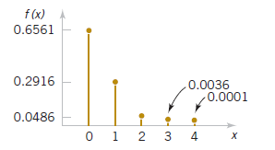
3.2 Probability Distributions and Probability Mass Functions
Figure: Probability distribution for bits in error.

Slide 11

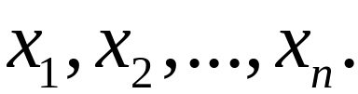
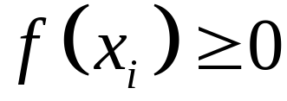
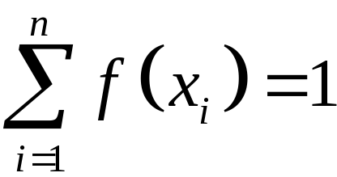
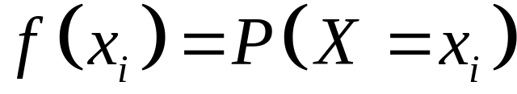
3.2 Probability Distributions and Probability Mass Functions
3.2.2 Probability Mass Functions
Definition: For a discrete random variable with
possible values
A probability mass function is a function such that
(a)
(b)
(c)

Slide 12
Example (Wafer Contamination):
Let the random variable X denote the number of semiconductor wafers that need to be analyzed in order to detect a large particle of contamination. Assume that the probability that a wafer contains a large particle is 0.01 and that the wafers are independent.
Determine the probability distribution of X.
Notes:
Detect: nhan ra, phat hien ra;

Slide 13
Solution:
Let p denote a wafer in which a large particle is present, and let a denote a wafer in which it is absent. The sample space of the experiment is infinite, and it can be represented as all possible sequences that start with a string of a’s and end with p. That is,
s = {p, ap, aap, aaap, aaaap, aaaaap, and so forth}
Consider a few special cases. We have P(X = 1) = P(p) = 0.01. Also, using the independence assumption,
P(X = 2) = P(ap) = 0.99(0.01) = 0.0099
Notes:
Detect: nhan ra, phat hien ra;

Slide 14
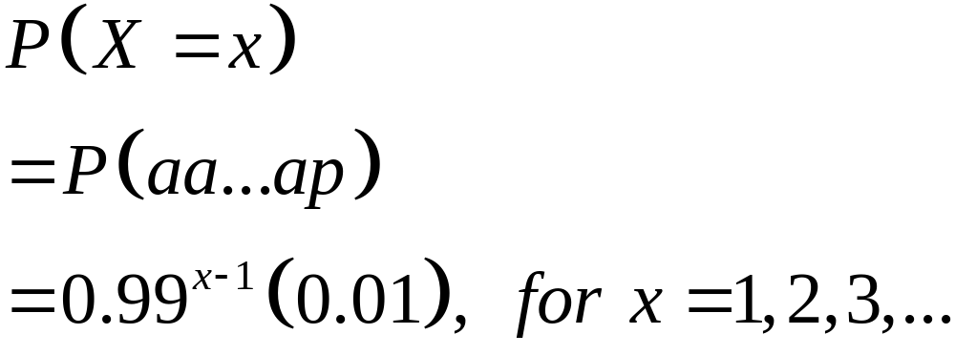
Solution:
A general formula is
Describing the probabilities associated with X in terms of this formula is a simple method to define the distribution of X in this example. Clearly f (x) ≥ 0. The fact that the sum of the probabilities is 1 is left as an exercise.
Notes:
Detect: nhan ra, phat hien ra;

Slide 15
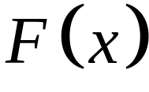
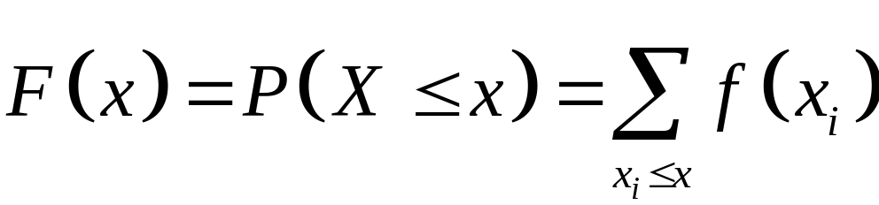
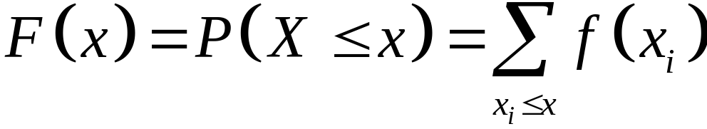
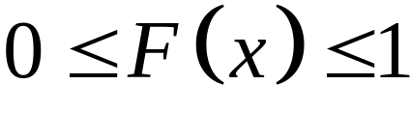

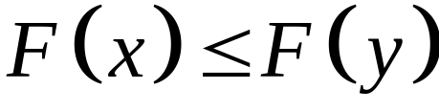
3.3 Cumulative Distribution Functions
Definition: The cumulative distribution function of
a discrete random variable ,denoted as , is
(a)
(b)
(c) If then

Slide 16
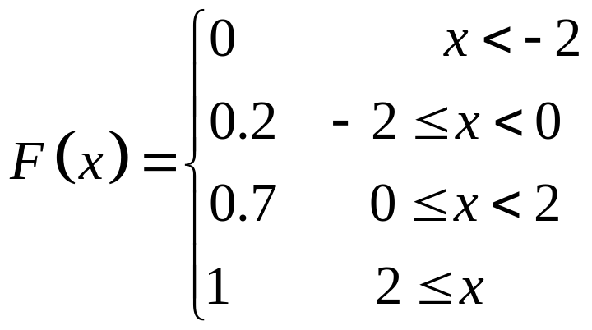
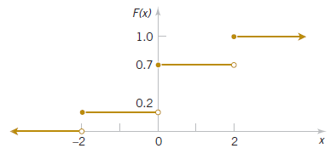
3.3 Cumulative Distribution Functions
Example 1 (Cumulative Distribution Function)
Determine the probability mass function of X from the following cumulative distribution function:
Cumulative Distribution Function

Slide 17
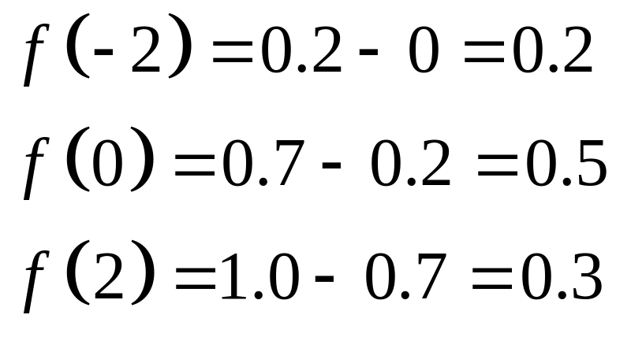
3.3 Cumulative Distribution Functions
Solution:
The probability mass function at each point is the change in the cumulative distribution function at the point. Therefore,

Slide 18
3.3 Cumulative Distribution Functions
Example 2:
Suppose that a day’s production of 850 manufactured parts contains 50 parts that do not conform to customer requirements. Two parts are selected at random, without replacement, from the batch. Let the random variable X equal the number of nonconforming parts in the sample.
What is the cumulative distribution function of X ?

Slide 19
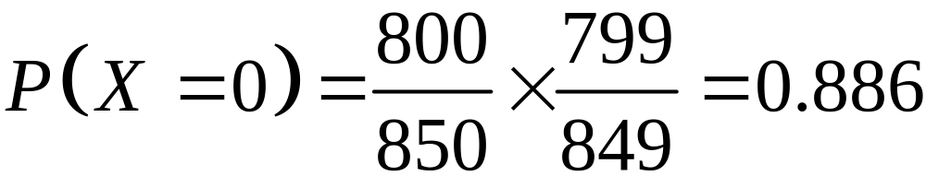
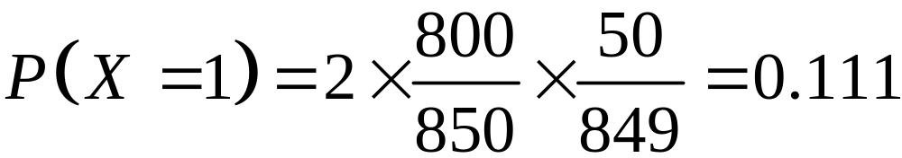
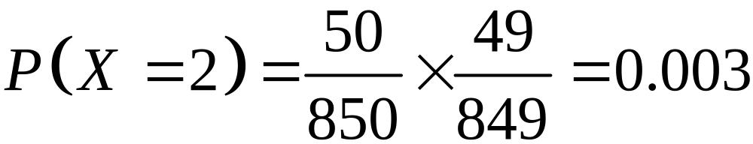
3.3 Cumulative Distribution Functions
Solution:
The first finding the probability mass function of X.

Slide 20
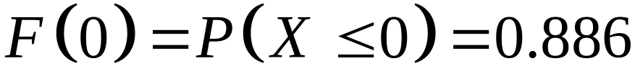
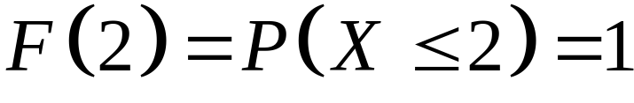
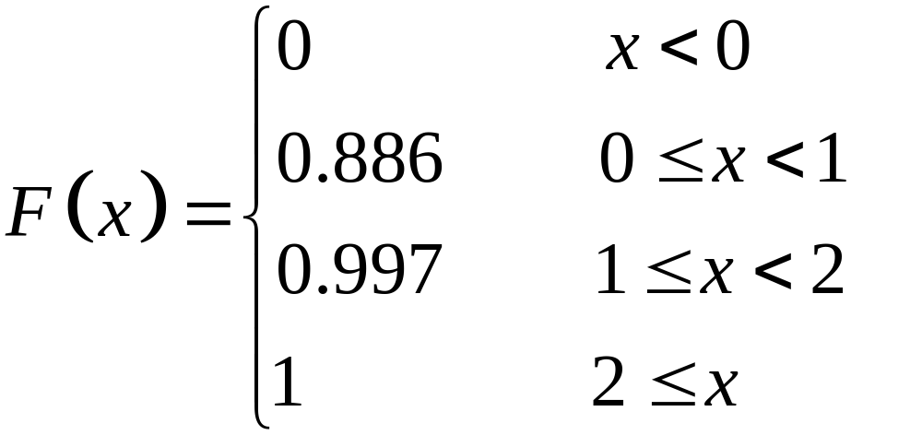
3.3 Cumulative Distribution Functions
Solution:
Therefore
The cumulative distribution function of X

Slide 21
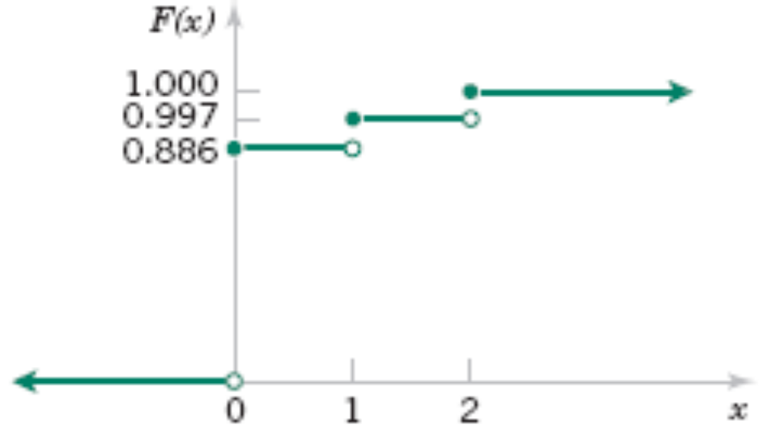
3.3 Cumulative Distribution Functions
Figure: Cumulative distribution function for example 2

Slide 22
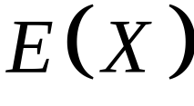

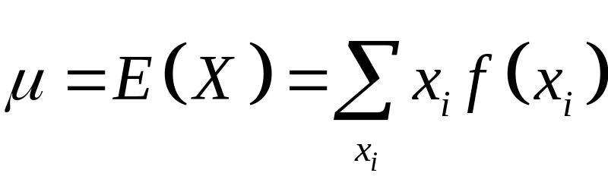
3.4 Mean and Variance of a Discrete Random Variable
3.4.1 Mean:
Definition: The mean or expected value of the
discrete random variable , denoted as or is

Slide 23

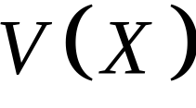
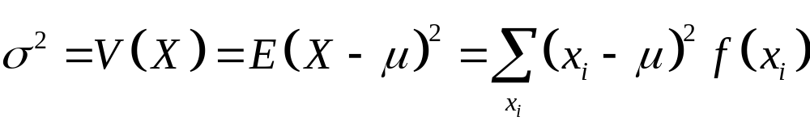
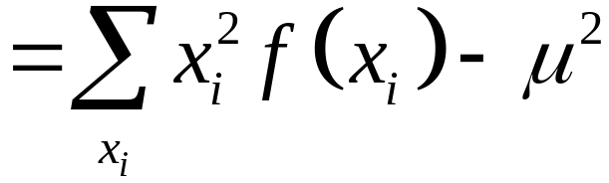
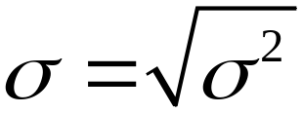
3.4 Mean and Variance of a Discrete Random Variable
3.4.2 Variance of a Discrete Random Variable
Definition: The variance value of the discret random variable , denoted as or is
The standard deviation of is

Slide 24

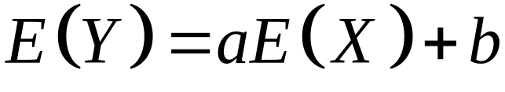
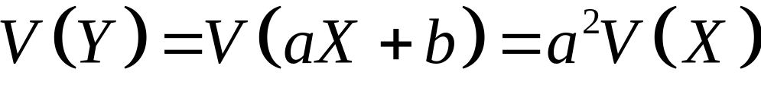
3.4 Mean and Variance of a Discrete Random Variable
The properties of mean and variance
a/ Let
b/

Slide 25
3.4 Mean and Variance of a Discrete Random Variable
Example: The number of messages sent per hour over
a computer network has the following distribution:
Determine the mean and standard deviation of the
number of messages sent per hour ?
x= number of messages | 10 | 11 | 12 | 13 | 14 | 15
f(x) | 0.08 | 0.15 | 0.3 | 0.2 | 0.2 | 0.07

Slide 26
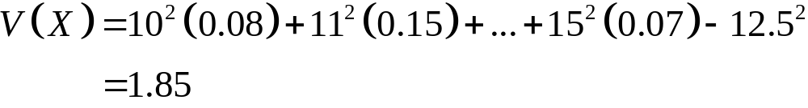
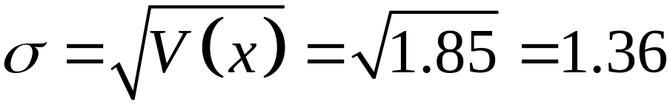
3.4 Mean and Variance of a Discrete Random Variable
Solution
x= number of messages | 10 | 11 | 12 | 13 | 14 | 15
f(x) | 0.08 | 0.15 | 0.3 | 0.2 | 0.2 | 0.07

Slide 27
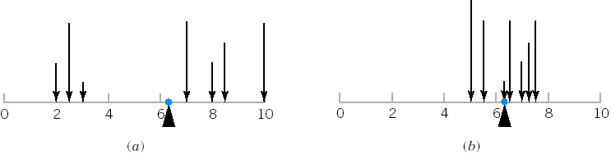
3.4 Mean and Variance of a Discrete Random Variable
Example 2:
Figure 1: A probability distribution can be viewed as a loading with the mean equal to the balance point. Parts (a) and (b) illustrate equal means, but Part (a) illustrates a larger variance.

Slide 28
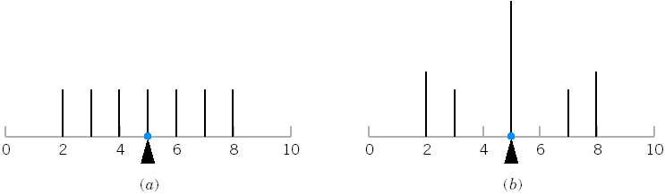
3.4 Mean and Variance of a Discrete Random Variable
Example 3:
Figure 2: The probability distribution illustrated in Parts (a) and (b) differ even though they have equal means and equal variances.

Slide 29

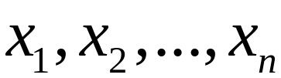
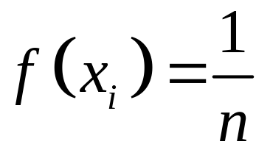
3.5 Discrete Uniform Distribution
Definition
A random variable has a discrete uniform
distribution if each of the values in its range, say,
has equal probability. Then

Slide 30


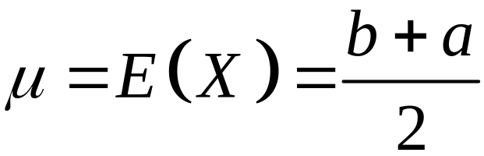

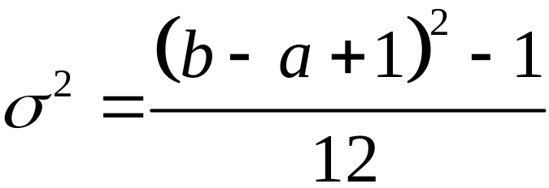
3.5 Discrete Uniform Distribution
Mean and Variance
Suppose is a discrete uniform random variable on
the consecutive integers for .
The mean of is
The variance of is
Notes:
Consecutive: liên tiếp

Slide 31
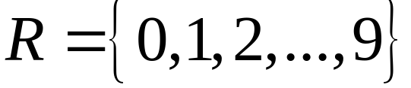
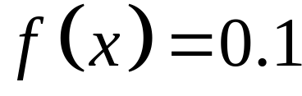

3.5 Discrete Uniform Distribution
Example 1:
The first digit of a part’s serial number is equally
likely to be any one of the digits 0 through 9. If
one part is selected from a large batch and X is
the first digit of the serial number, X has a
discrete uniform distribution with probability 0.1
for each value in . That is,
for each value in . The probability mass function
of X is shown in Fig 1.

Slide 32
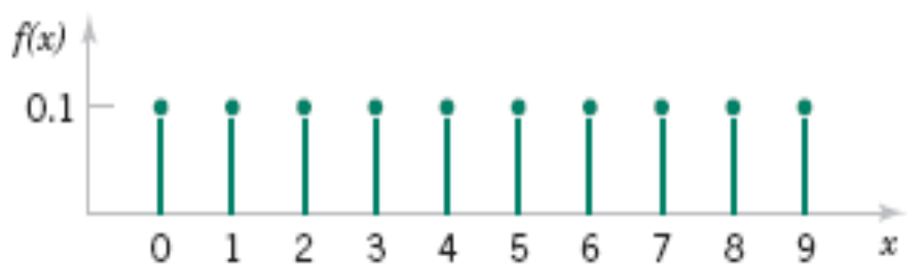
3.5 Discrete Uniform Distribution
Figure 1: Probability mass function for a discrete uniform random variable.

Slide 33
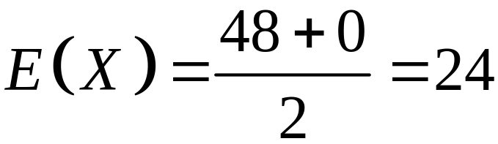
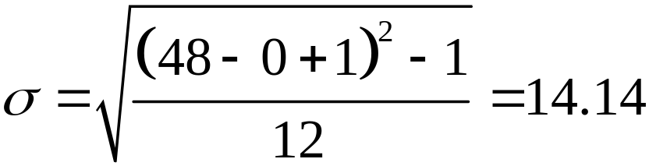
3.5 Discrete Uniform Distribution
Example 2:
Let the random variable X denote the number of
the voice lines that are in use at a particular time.
Assume that X is a discrete uniform random
variable with a range of 0 to 48. Then,
Notes:
Consecutive: liên tiếp

Slide 34




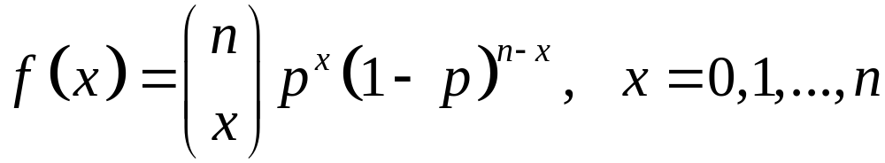
3.6 Binomial Distribution
Definition: A random experiment consists of
Bernoulli trials such that
(a) The trials are independent.
(b) Each trial results in only two possible outcomes, labeled as “ success” and “failure”.
(c) The probability of a success in each trial, denoted as , remains constant has a binomial random variable with paramiters and
Then probability mass function of is

Slide 35

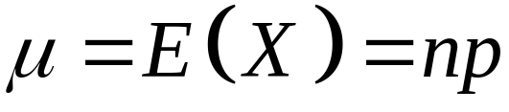
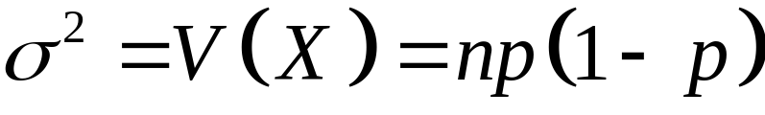
3.6 Binomial Distribution
Mean and Variance
If is a binomial random variable with parameters and

Slide 36
3.6 Binomial Distribution
Example 1: Consider the following random
experiments and random variables:
1.Flip a coin 10 times. Let X = number of heads obtained.
2. A worn machine tool produces 1% defective parts. Let X = number of defective parts in the next 25 parts produced.
3. Each sample of air has a 10% chance of containing a particular rare molecule. Let X = the number of air samples that contain the rare molecule in the next 18 samples analyzed.

Slide 37
3.6 Binomial Distribution
Example 1:
4. Of all bits transmitted through a digital transmission channel, 10% are received in error. Let X = the number of bits in error in the next five bits transmitted.
5. A multiple-choice test contains 10 questions, each with four choices, and you guess at each question. Let X = the number of questions answered correctly.
6. In the next 20 births at a hospital, let X = the number of female births.
7. Of all patients suffering a particular illness, 35% experience improvement from a particular medication. In the next 100 patients administered the medication, let X = the number of patients who experience improvement.

Slide 38
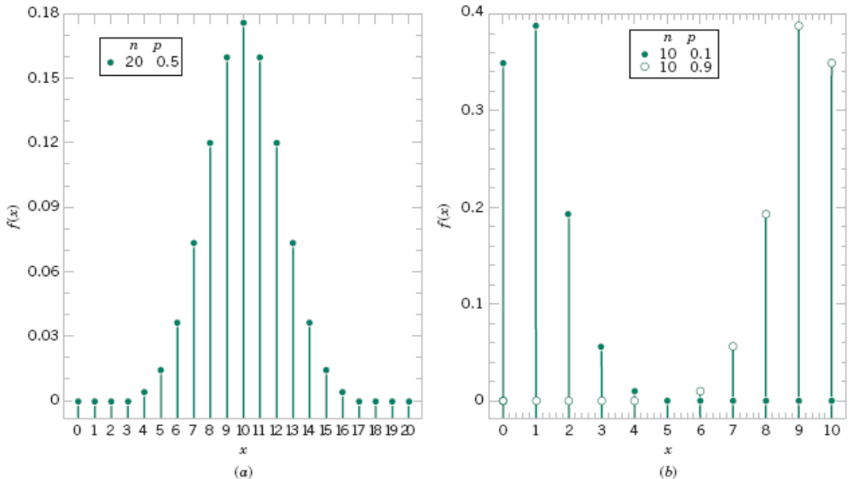
3.6 Binomial Distribution
Figure: Binomial distributions for selected values of n and p.

Slide 39

3.6 Binomial Distribution
Example 2: Each sample of water has a 10% chance
of containing a particular organic pollutant.Assume
that the samples are independent with regard to the
presence of the pollutant, in the next 18 samples.
a/ Find the probability that exactly 2 contain the pollutant.
b/ Determine the probability that at least four
samples contain the pollutant.
c/ Determine the probability that

Slide 40




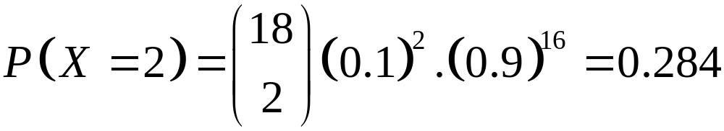
3.6 Binomial Distribution
Solution:
Let the number of samples that contain the pollutant in the next 18 samples analyzed.
Then is a binomial random variable with
. Then
a/

Slide 41
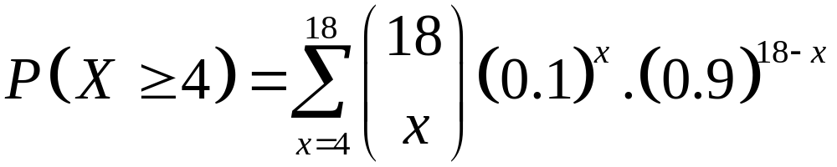
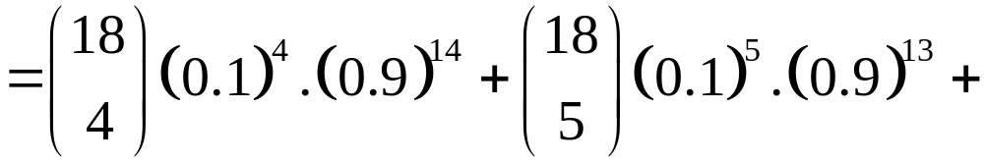
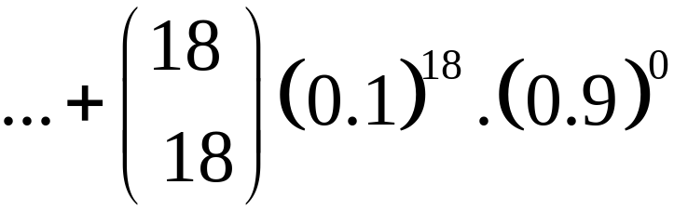
3.6 Binomial Distribution
Solution:
b/ The requested probability is

Slide 42



3.6 Binomial Distribution
However, it is easier to use the complementary event,

Slide 43


3.6 Binomial Distribution
Solution:
c/

Slide 44
3.6 Binomial Distribution
Practical Interpretation:
Binomial random variables are used to model many
physical systems and probabilities for all such
models can be obtained from the binomial
probability mass function.

Slide 45
3.6 Binomial Distribution
Example 3: The phone lines to an airline reservation
system are occupied 40% of the time. Assume that
the events that the lines are occupied on successive
calls are independent. Assume that 10 calls are
placed to the airline.
(a) What is the probability that for exactly
three calls, the lines are occupied ?
(b) What is the probability that for at least one call, the lines are not occupied ?
(c) What is the expected number of calls in which the lines are all occupied?

Slide 46
3.6 Binomial Distribution
Solution:
(a) 0.215 (b) 0.994 (c) 4

Slide 47
3.7 Geometric and Negative Binomial Distributions
3.7.1 Geometric distribution
Definition:
In a series of Bernoulli trials (independent trials
with constant probability of a success), let the
random variable denote the number of trials until
the first success. Then is a geometric random
variable with parameter and

Slide 48


3.7 Geometric and Negative Binomial Distributions
Definition: If is a geometric random variable with parameter

Slide 49
3.7 Geometric and Negative Binomial Distributions
Example:
The probability that a wafer contains a large
particle of contamination is 0.01. If it is assumed
that the wafers are independent, what is the
probability that exactly 125 wafers need to be
analyzed before a large particle is detected ?

Slide 50

3.7 Geometric and Negative Binomial Distributions
Solution:
Let denote the number of sample analyzed until a lagre particle is detected.
is geometric random variable with
The probability that exactly 125 wafers need to be
analyzed before a large particle is detected

Slide 51

3.7 Geometric and Negative Binomial Distributions
3.7.2 Negative Binomial Distribution
Definition:
A generalization of a geometric distribution in
which the random variable is the number of
Bernoulli trials required to obtain successes
results in the negative binomial distribution.

Slide 52




3.7 Geometric and Negative Binomial Distributions
3.7.2 Negative Binomial Distribution
Definition: In a series of Bernoulli trials
(independent trials with constant probability of
a success), let the random variable denote the
number of trials until success. Then is a
negative binomial random variable with
parameter and and

Slide 53


3.7 Geometric and Negative Binomial Distributions
3.7.2 Negative Binomial Distribution
If is a negative binomial random variable with
parameter and ,

Slide 54
3.7 Geometric and Negative Binomial Distributions
Example 1:
The probability that a camera passes the test is 0.8,
and the cameras perform independently.
a/ What is the probability that the third failure is obtained in six tests ?
b/ What is the probability that the third failure is obtained in five fewer tests ?

Slide 55


3.7 Geometric and Negative Binomial Distributions
Solution:
Let is the number of camera tested until the third
failure.
a/
b/

Slide 56
3.7 Geometric and Negative Binomial Distributions
Example 2:
The probability of a successful optical alignment
in the assembly of an optical data storage product
is 0.8. Assume that the trials are independent.
a/ What is the probability that the first successful alignment requires exactly four trials ?
b/ What is the probability that the first successful alignment requires at most four trials ?
c/ What is the probability that the first successful alignment requires at least four trials ?

Slide 57



3.7 Geometric and Negative Binomial Distributions
Solution:
a/
b/
c/

Slide 58





3.8 Hypergeometric Distribution
Definition: A set of objects contains.
objects classified as failures.
A sample of size n objects is selected randomly (without replacement) from the objects where
and .
The random variable that equals the number of successes in the sample is a hypergeometric random variable and

Slide 59





3.8 Hypergeometric Distribution
Mean and Variance
If X is a hypergeometric random variable with parameters
and , then
where

Slide 60
3.8 Hypergeometric Distribution
Example: A batch of parts contains 100 from a local supplier of tubing and 200 from a supplier of tubing in the next state. If four parts are selected randomly and without replacement.
a/ What is the probability they are all from the
local supplier ?
b/ What is the probability that two or more parts in the sample are from the local supplier ?
c/ What is the probability that at least one part in the sample is from the local supplier ?

Slide 61



3.8 Hypergeometric Distribution
Solution:
Let equal the number of parts in the sample from
local supplier.
a/
b/
c/

Slide 62

3.8 Hypergeometric Distribution
Finite Population Correction Factor
The term in the variance of a hypergeometric
random variable
Is called the finite population correction factor.

Slide 63

3.8 Hypergeometric Distribution
Comparison of hypergeometric and binomial distributions.

Slide 64


3.9 Poisson Distribution
Definition:
The random variable that equals the number of events in a Poisson process is a Poisson random variable with parameter and
λ is the mean number of events per unit length

Slide 65


3.9 Poisson Distribution
Mean and Variance
If is a Poisson random variable with parameter

Slide 66
3.9 Poisson Distribution
Example 1:
For the case of the thin copper wire, suppose that the number of flaws follows a Poisson distribution with a mean of 2.3 flaws per millimeter.
a/ Determine the probability of exactly two flaws in 1 millimeter of wire.
b/ Determine the probability of 10 flaws in 5 millimeters of wire.
c/ Determine the probability of at least one flaw in 2 millimeters of wire.

Slide 67




3.9.Poisson Distribution
Solution
Let equal the number of flaws in 1 millimeter of
wire.
a/
b/
c/

Slide 68
3.9.Poisson Distribution
Example 2
The number of telephone calls that arrive at a phone exchange is often modeled as a Poisson random variable. Assume that on the average there are 10 calls per hour.
a/ What is the probability that there are exactly 5 calls in one hour ?
b/ What is the probability that there are 3 or fewer calls in one hour ?

Slide 69
3.9 Poisson Distribution
Example 2
c/ What is the probability that there are exactly 15 calls in two hours ?
d/ What is the probability that there are exactly 5 calls in 30 minutes ?

Slide 70




3.9 Poisson Distribution
Solution:
a/
b/
c/
d/

